Slide 1

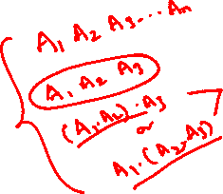
CS F222: Discrete Structures
for
Computer Science
Topic: Recurrence relations
Dr. Raghunath Reddy

Slide 2
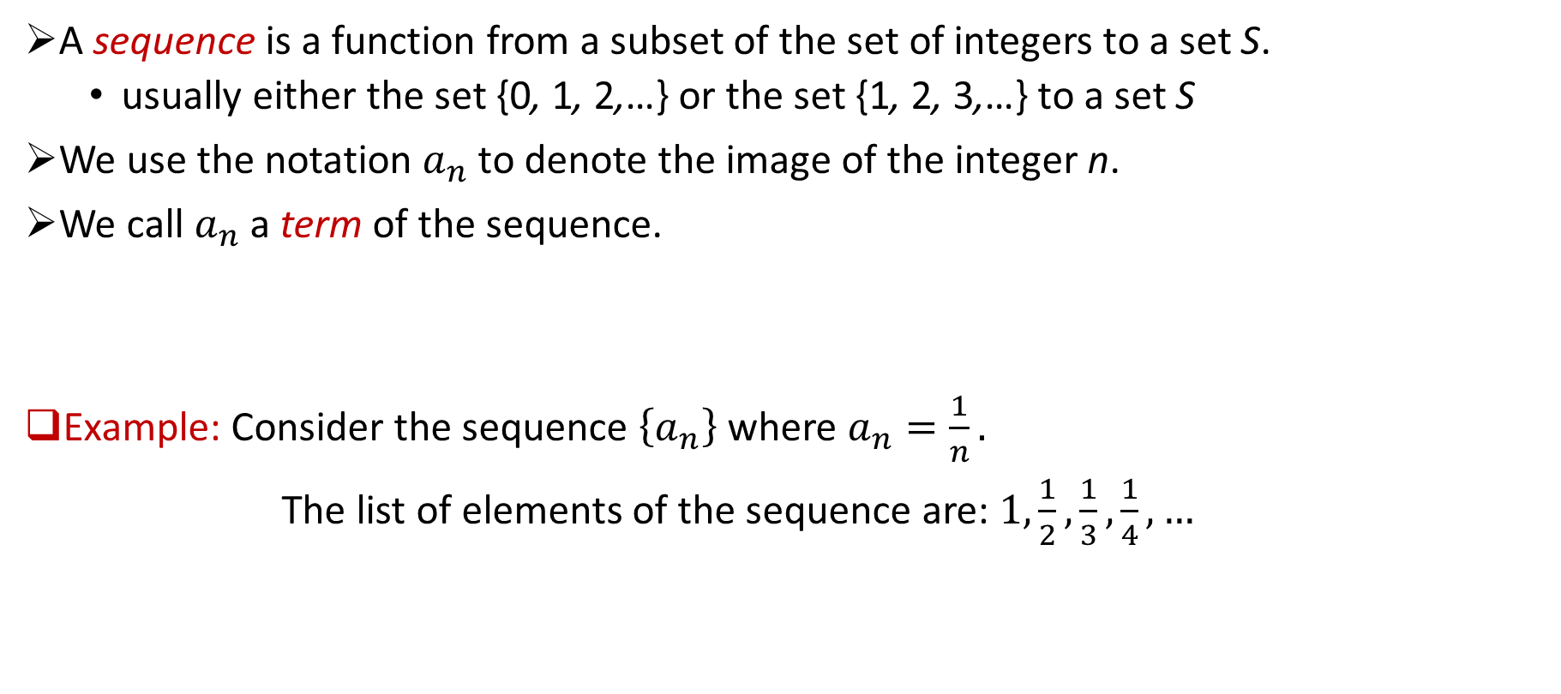
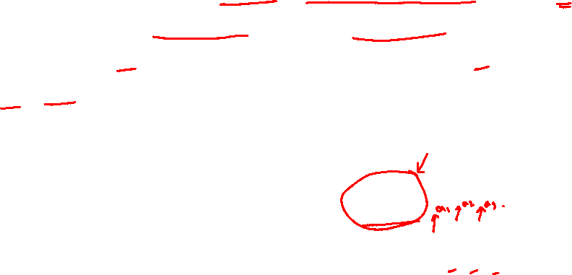
Sequences
A sequence is a function from a subset of the set of integers to a set S.
usually either the set {0, 1, 2,…} or the set {1, 2, 3,…} to a set S
We use the notation $a_{n}$ to denote the image of the integer n.
We call $a_{n}$ a term of the sequence.
Example: Consider the sequence $\left\{a_{n}\right\}$where $a_{n}=\frac{1}{n}.$
The list of elements of the sequence are: $1,\frac{1}{2},\frac{1}{3},\frac{1}{4},…$

Slide 3
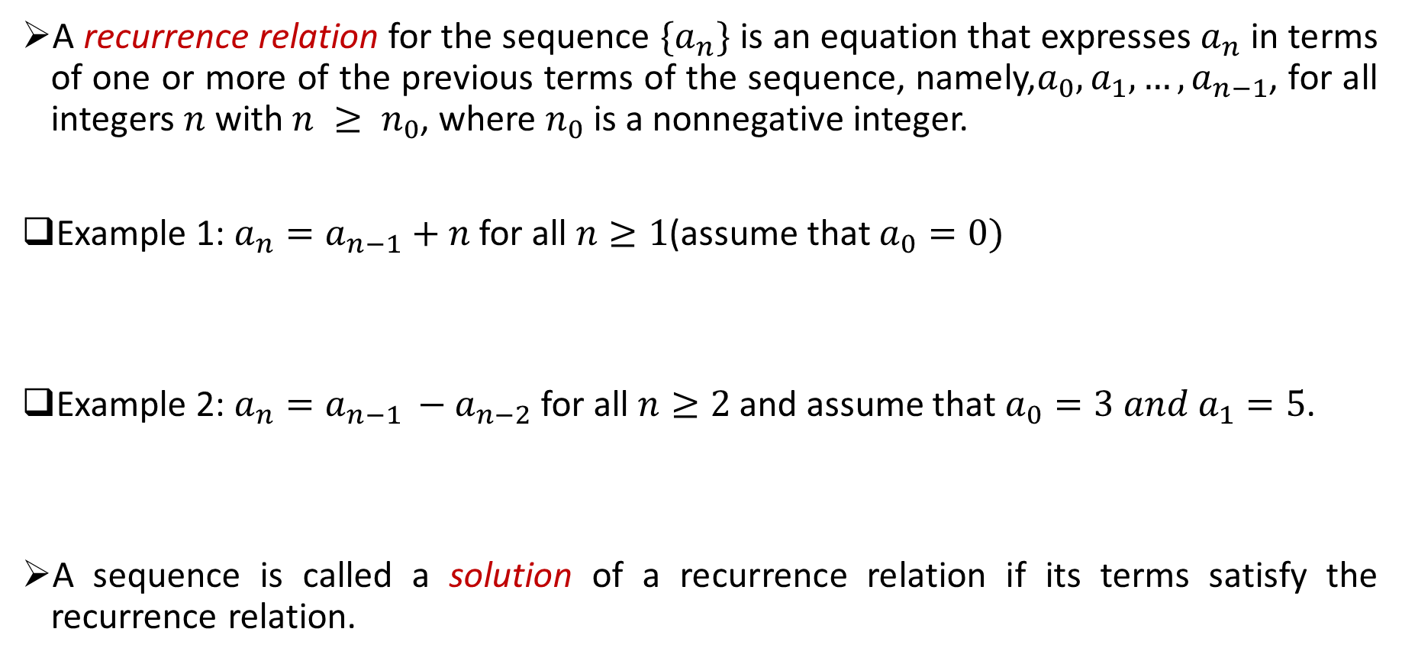
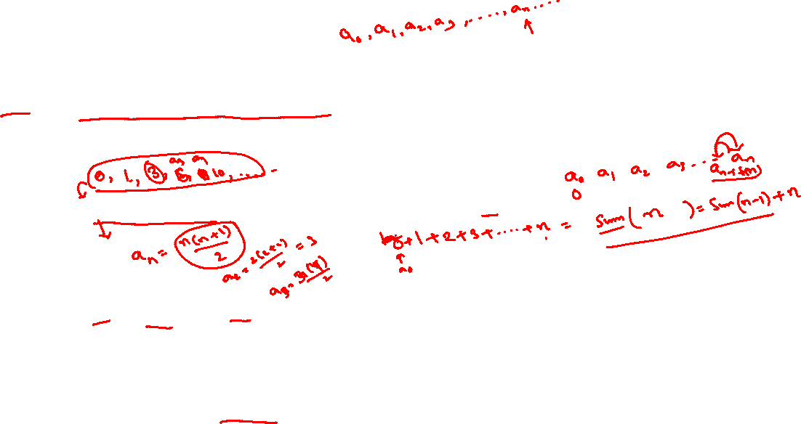
Recurrence relation
A recurrence relation for the sequence $\{a_{n}\}$ is an equation that expresses $a_{n}$ in terms of one or more of the previous terms of the sequence, namely,$a_{0}, a_{1},…, a_{n−1}$, for all integers $n$ with $n ≥ n_{0}$, where $n_{0}$ is a nonnegative integer.
Example 1: $a_{n}=a_{n−1}+n$ for all $n≥1$(assume that $a_{0}=0)$
Example 2: $a_{n}=a_{n−1 }−a_{n−2}$for all $n≥2$ and assume that $a_{0}=3 and a_{1}=5$.
A sequence is called a solution of a recurrence relation if its terms satisfy the recurrence relation.

Slide 4

Recurrence relation
A recurrence relation for the sequence $\{a_{n}\}$ is an equation that expresses $a_{n}$ in terms of one or more of the previous terms of the sequence, namely,${ a}_{0}, a_{1},…, a_{n−1}$, for all integers $n$ with $n ≥ n_{0}$, where $n_{0}$ is a nonnegative integer.
Example 1: $a_{n}=a_{n−1}+n$ for all $n≥1$(assume that $a_{0}=0)$
Example 2: $a_{n}=a_{n−1 }−a_{n−2}$for all $n≥2$ and assume that $a_{0}=3 and a_{1}=5$.
A sequence is called a solution of a recurrence relation if its terms satisfy the recurrence relation.

Slide 5

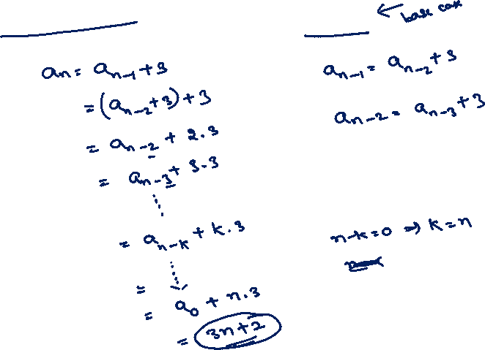
Iterative method
Solve $a_{n}=a_{n−1}+3$for all $n≥1$ and $a_{0}=2$.

Slide 6

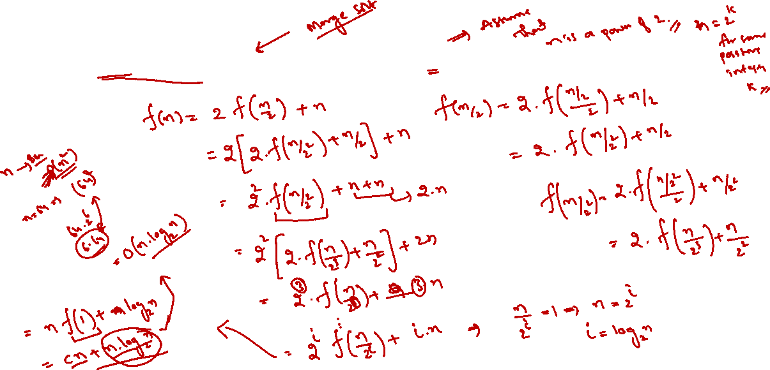
Iterative method
Solve $f\left(n\right)=2f\left(\frac{n}{2}\right)+n$for all $n≥2$ and $f\left(1\right)=c$ where $c$is some constant.

Slide 7

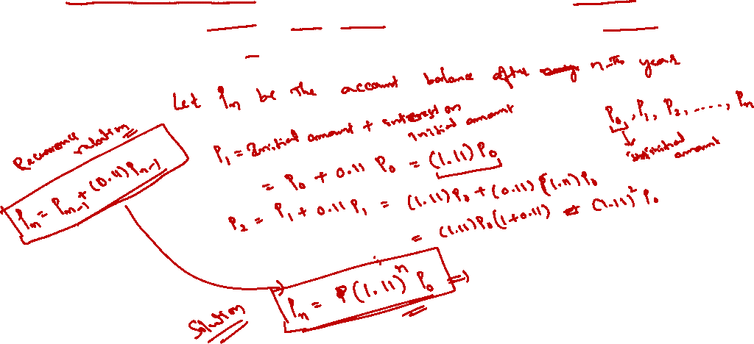
Modeling recurrence relations
Compound Interest Suppose that a person deposits $10,000 in a savings account at a bank yielding 11% per year with interest compounded annually. How much will be in the account after $n$ years?

Slide 8

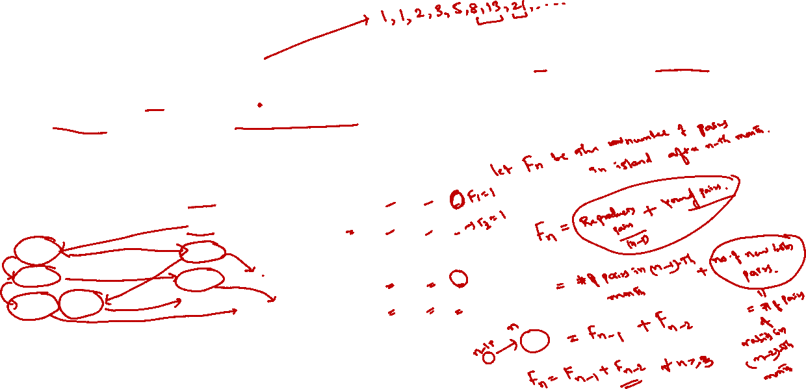
Modeling recurrence relations
Rabbits and the Fibonacci Numbers A young pair of rabbits (one of each sex) is placed on an island. A pair of rabbits does not breed until they are 2 months old. After they are 2 months old, each pair of rabbits produces another pair each month, Find a recurrence relation for the number of pairs of rabbits on the island after $n$ months, assuming that no rabbits ever die.

Slide 9
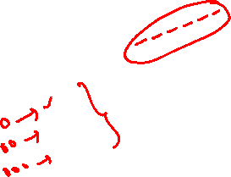

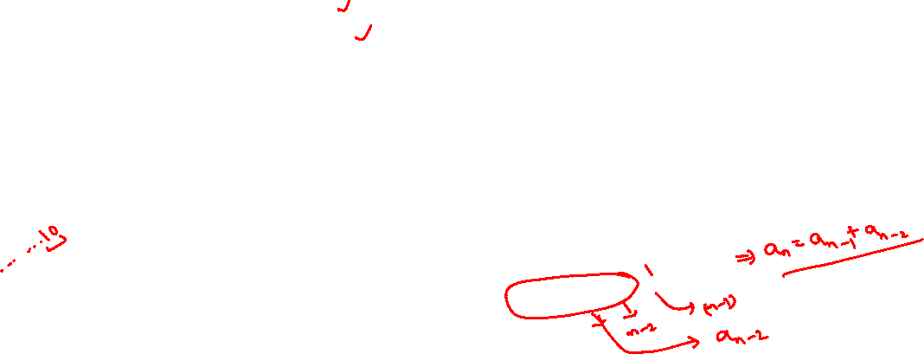
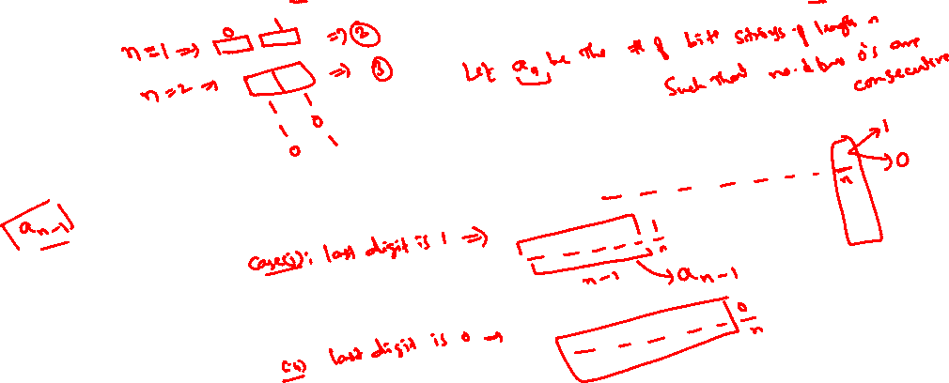
Modeling recurrence relations
Find a recurrence relation and give initial conditions for the number of bit strings of length$n$ that do not have two consecutive 0s.

Slide 10
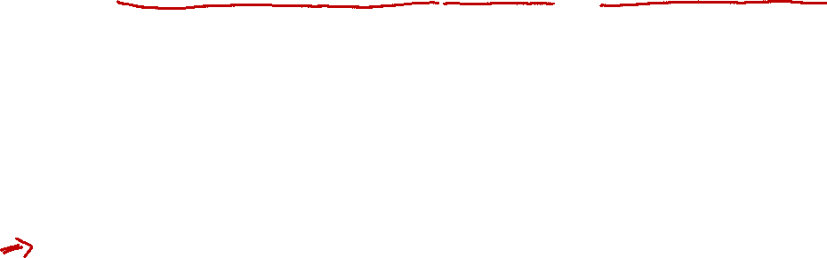
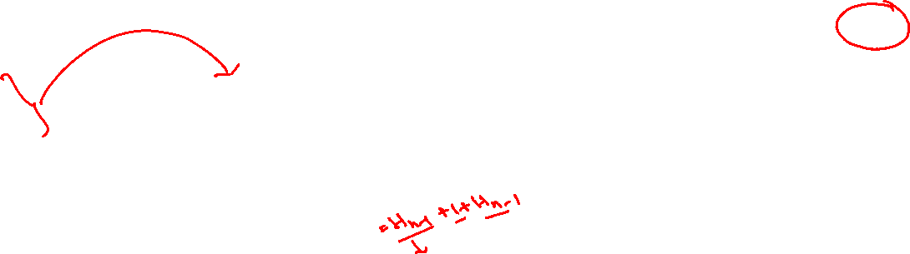

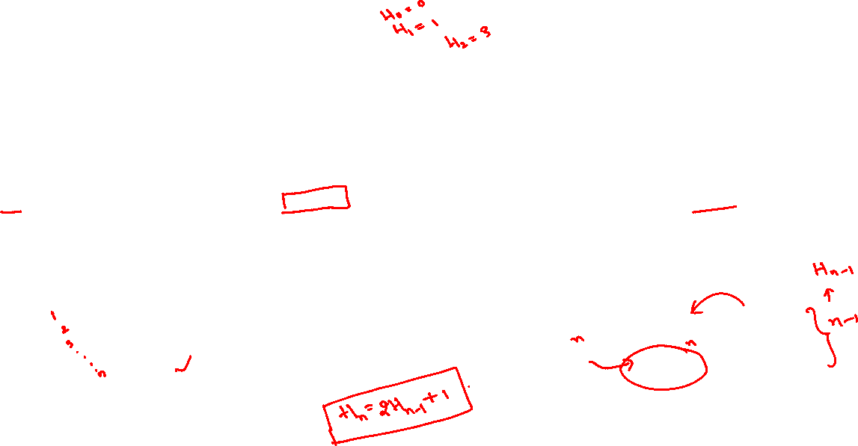
Modeling recurrence relations
Tower of Hanoi, consists of three pegs mounted on a board together with disks of different sizes. Initially these disks are placed on the first peg in order of size, with the largest on the bottom. The rules of the puzzle allow disks to be moved one at a time from one peg to another as long as a disk is never placed on top of a smaller disk. The goal of the puzzle is to have all the disks on the second peg in order of size, with the largest on the bottom.
Let $H_{n}$ denote the number of moves needed to solve the Tower of Hanoi puzzle with n disks. Set up a recurrence relation for the sequence $\left\{H_{n}\right\}$.

Slide 11

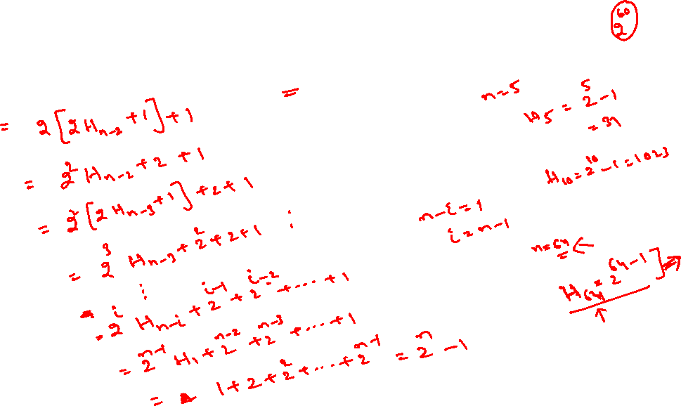
Modeling recurrence relations (Tower of Hanoi)
$H_{n}=2 H_{n−1 }+1$for all $n≥2$and $H_{1}=1$

Slide 12
Solving Linear recurrence relations

Slide 13
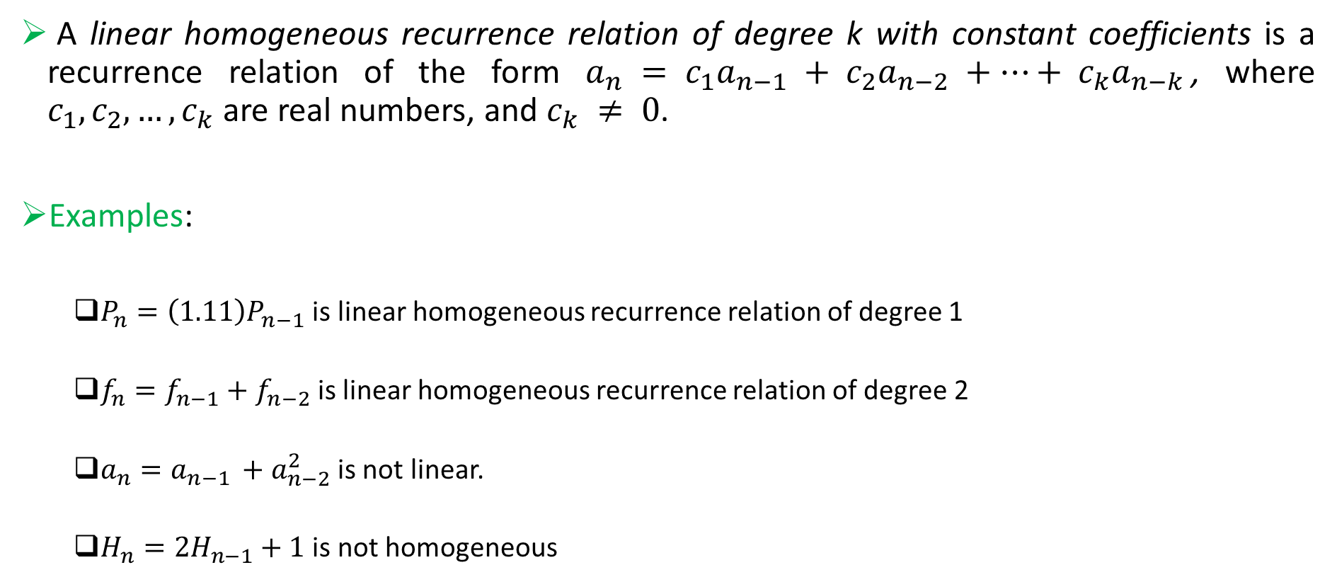
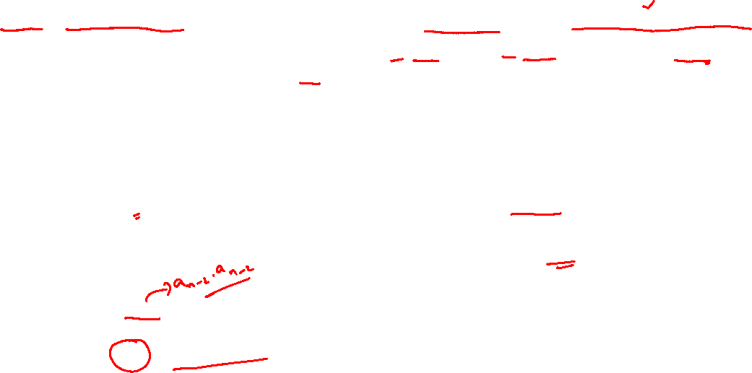
Linear Homogeneous Recurrence Relation
A linear homogeneous recurrence relation of degree k with constant coefficients is a recurrence relation of the form $a_{n} = c_{1}a_{n−1} + c_{2}a_{n−2} +⋯+ c_{k}a_{n−k}$, where $c_{1}, c_{2},…, c_{k}$are real numbers, and $c_{k} ≠ 0$.
Examples:
$P_{n}=\left(1.11\right)P_{n−1}$ is linear homogeneous recurrence relation of degree 1
$f_{n}=f_{n−1}+f_{n−2}$is linear homogeneous recurrence relation of degree 2
$a_{n}=a_{n−1 }+a_{n−2}^{2}$is not linear.
$H_{n}=2H_{n−1}+1$ is not homogeneous

Slide 14
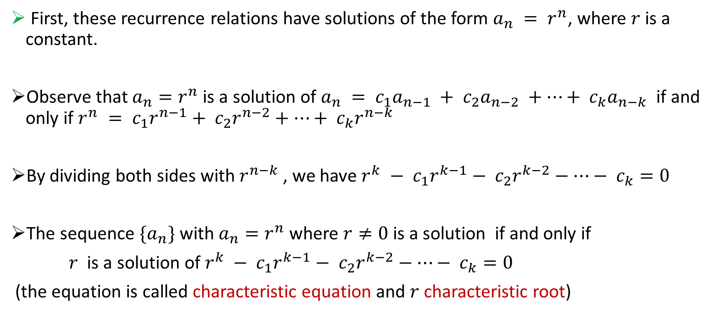
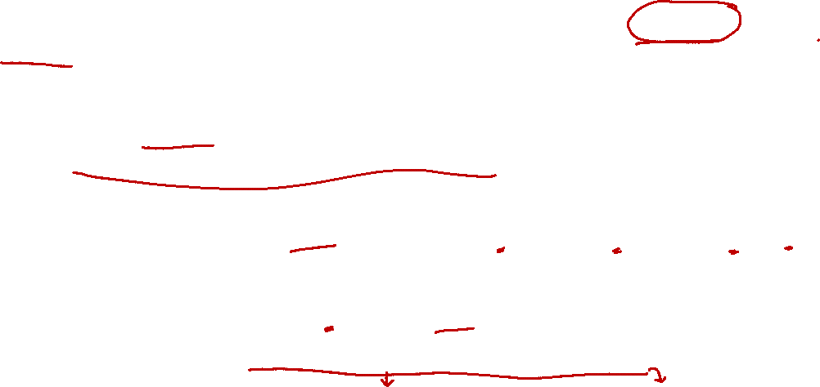
Solving Linear Homogeneous Recurrence Relation with constant coefficients
First, these recurrence relations have solutions of the form $a_{n} = r^{n}$, where $r$ is a constant.
Observe that $a_{n}=r^{n}$is a solution of $a_{n} = c_{1}a_{n−1} + c_{2}a_{n−2} +⋯+ c_{k}a_{n−k}$ if and only if $r^{n} = c_{1}r^{n−1}+ c_{2}r^{n−2}+⋯+ c_{k}r^{n−k}$
By dividing both sides with $r^{n−k}$, we have $r^{k} − c_{1}r^{k−1}− c_{2}r^{k−2}−⋯− c_{k}=0$
The sequence $\{a_{n}\}$ with $a_{n}=r^{n}$ where $r≠0$ is a solution if and only if
$r$ is a solution of $r^{k} − c_{1}r^{k−1}− c_{2}r^{k−2}−⋯− c_{k}=0$
(the equation is called characteristic equation and $r$characteristic root)

Slide 15
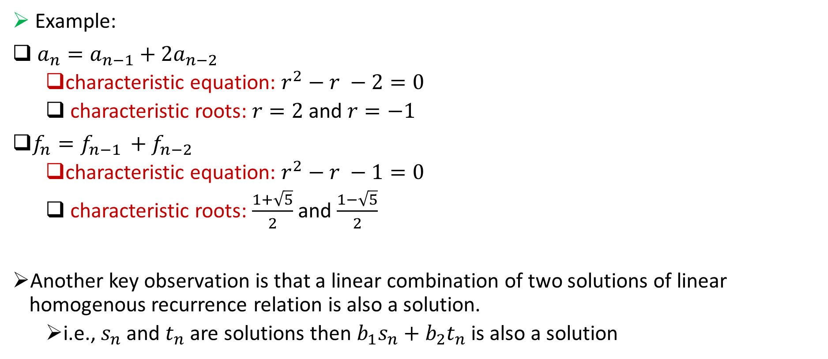
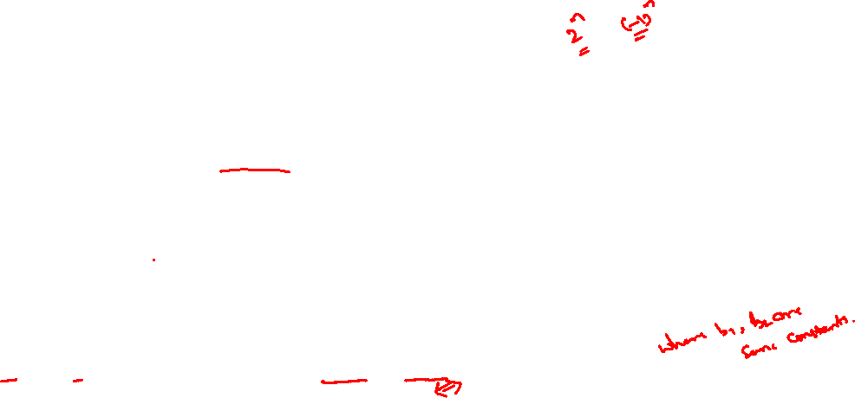
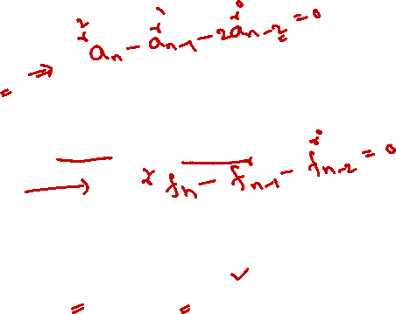
Solving Linear Homogeneous Recurrence Relation with constant coefficients
Example:
$a_{n}=a_{n−1}+2a_{n−2}$
characteristic equation: $r^{2}−r −2=0$
characteristic roots: $r=2$and $r=−1$
$f_{n}=f_{n−1 }+f_{n−2}$
characteristic equation: $r^{2}−r −1=0$
characteristic roots: $\frac{1+\sqrt{5}}{2}$ and $\frac{1−\sqrt{5}}{2}$
Another key observation is that a linear combination of two solutions of linear homogenous recurrence relation is also a solution.
i.e., $s_{n}$ and $t_{n}$ are solutions then $b_{1}s_{n}+b_{2}t_{n}$ is also a solution

Slide 16

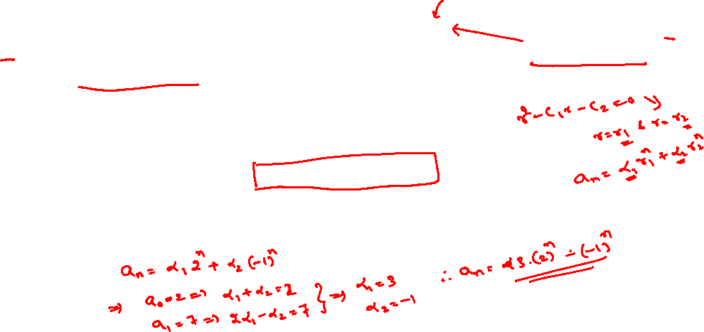
Solving Linear Homogeneous Recurrence Relation with constant coefficients
Example:
Solve $a_{n}=a_{n−1}+2a_{n−2}$with $a_{0}=2$ and $a_{1}=7$
characteristic equation: $r^{2}−r −2=0$
characteristic roots: $r=2$and $r=−1$
Solution:

Slide 17

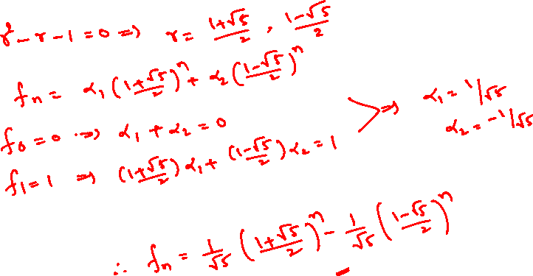
Solving Linear Homogeneous Recurrence Relation with constant coefficients
Example: Solve $f_{n}=f_{n−1 }+f_{n−2}$ with $f_{0}=0$ and $f_{1}=1$.

Slide 18

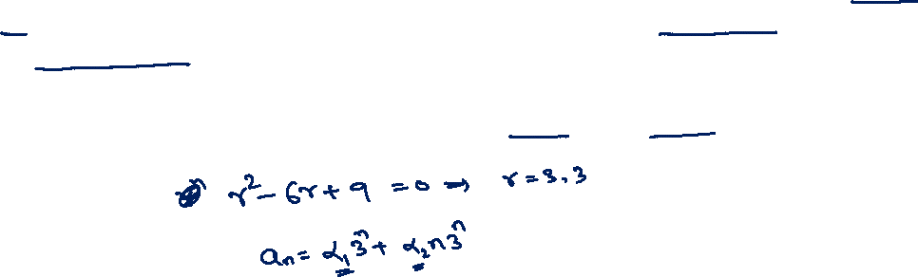
Solving Linear Homogeneous Recurrence Relation with constant coefficients
Example: Solve $a_{n}=6 a_{n−1 }−9a_{n−2}$ with $a_{0}=1$ and $a_{1}=6$

Slide 19

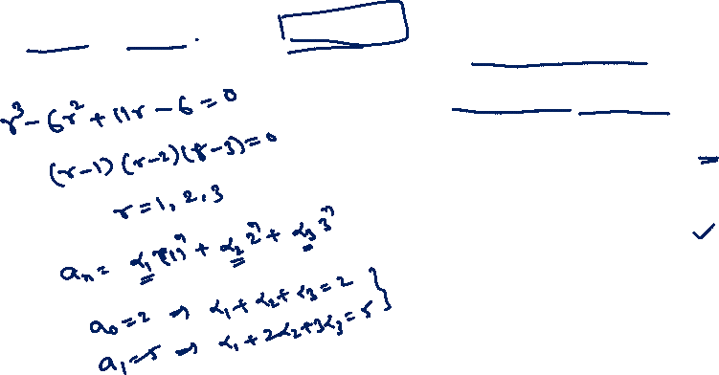
Solving Linear Homogeneous Recurrence Relation with constant coefficients
$a_{n}=6 a_{n−1 }−11a_{n−2}+6a_{n−3}$ with $a_{0}=2, a_{1}=5$, and $a_{2}=15$

Slide 20


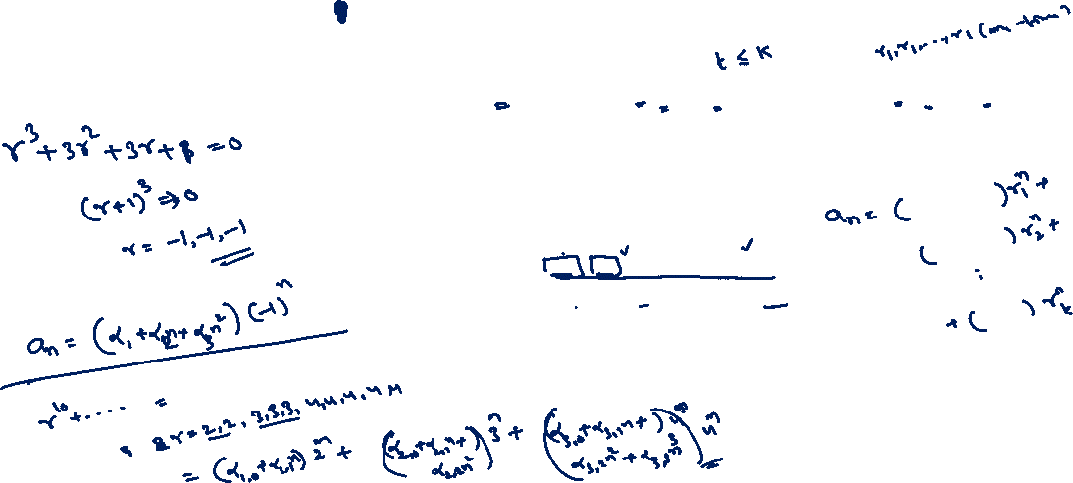
Solving Linear Homogeneous Recurrence Relation with constant coefficients
$a_{n}=−3 a_{n−1 }−3a_{n−2}−3a_{n−3}$ with $a_{0}=1, a_{1}=−2$, and $a_{2}=−1$

Slide 21
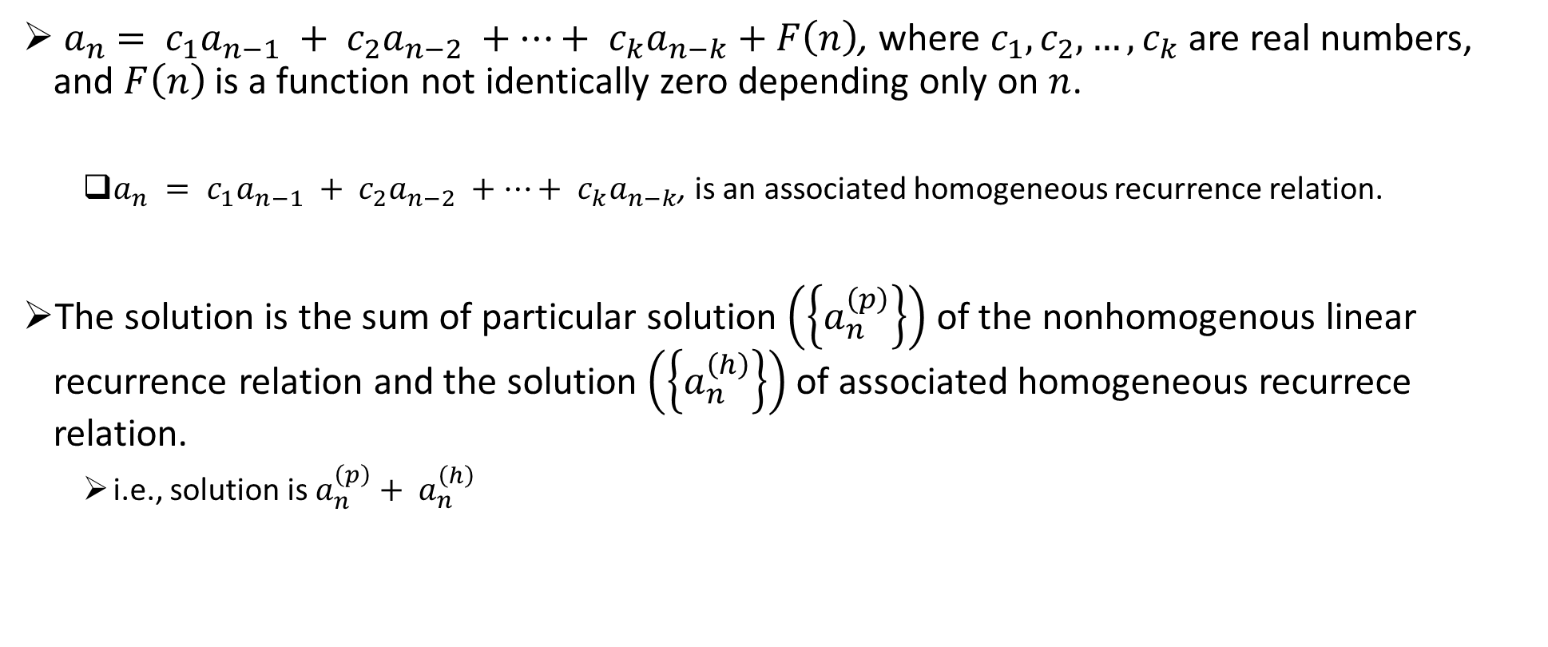
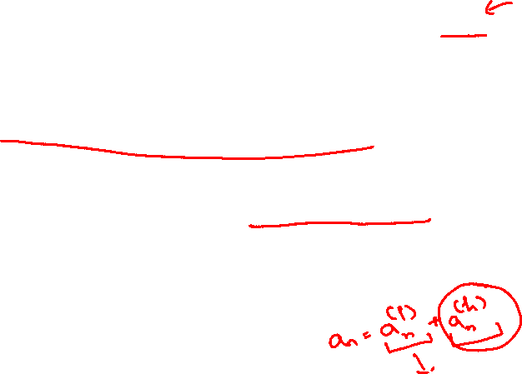
Linear Nonhomogeneous Recurrence Relation with constant coefficients
${ a}_{n} = c_{1}a_{n−1} + c_{2}a_{n−2} +⋯+ c_{k}a_{n−k}+F\left(n\right)$, where $c_{1}, c_{2},…, c_{k}$are real numbers, and $F\left(n\right)$ is a function not identically zero depending only on $n$.
$a_{n} = c_{1}a_{n−1} + c_{2}a_{n−2} +⋯+ c_{k}a_{n−k}$, is an associated homogeneous recurrence relation.
The solution is the sum of particular solution $\left(\left\{a_{n}^{\left(p\right)}\right\}\right)$ of the nonhomogenous linear recurrence relation and the solution $\left(\left\{a_{n}^{\left(h\right)}\right\}\right)$ of associated homogeneous recurrece relation.
i.e., solution is $a_{n}^{\left(p\right)}+ a_{n}^{\left(h\right)}$

Slide 22
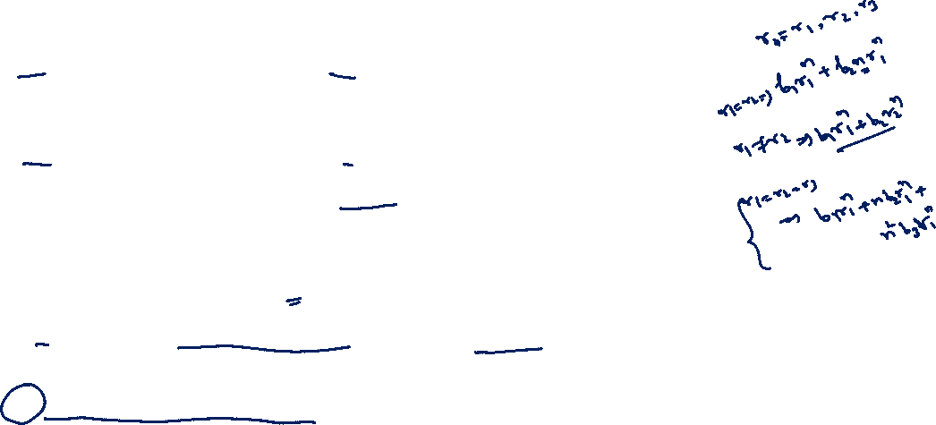
Linear Nonhomogeneous Recurrence Relation with constant coefficients

Slide 23

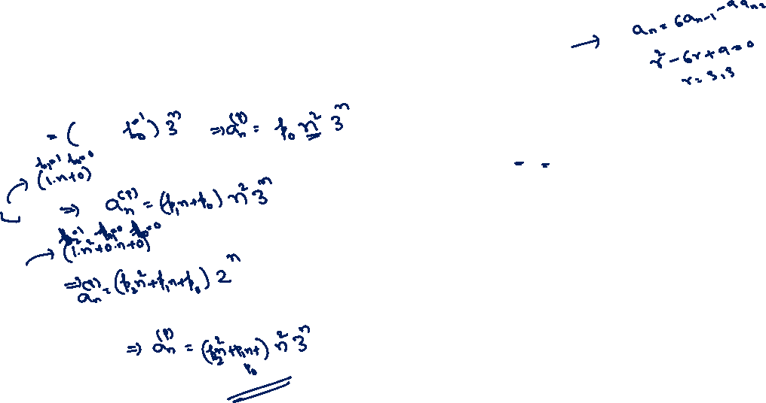
Linear Nonhomogeneous Recurrence Relation with constant coefficients
Example: Find the particular solution of $a_{n}=6 a_{n−1} −9 a_{n−2}+F\left(n\right)$
$F\left(n\right)=3^{n}$
$F\left(n\right)={n3}^{n}$
$F\left(n\right)={n^{2}2}^{n}$
$F\left(n\right)={\left(n^{2}+1\right)3}^{n}$

Slide 24
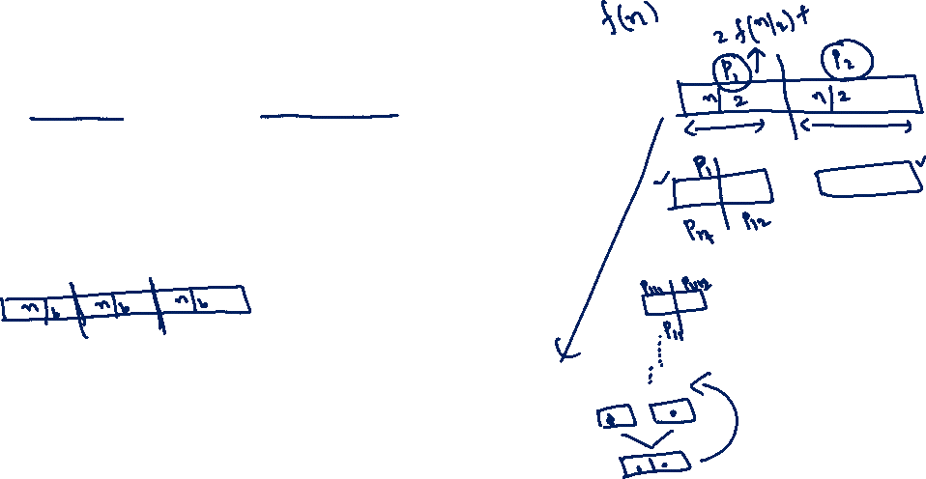
Divide-and-Conquer Algorithms
and
Recurrence Relations

Slide 25
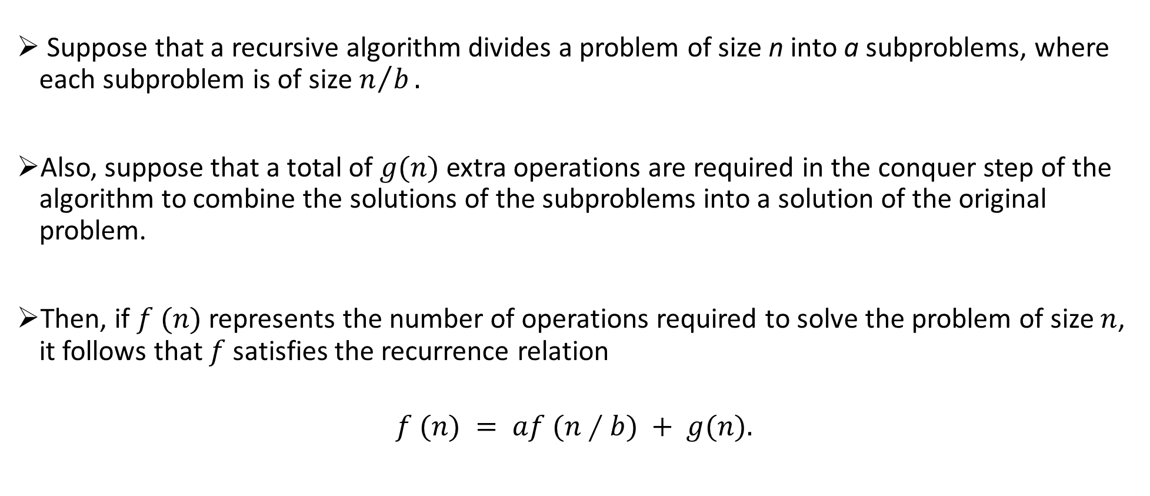
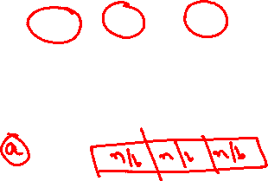
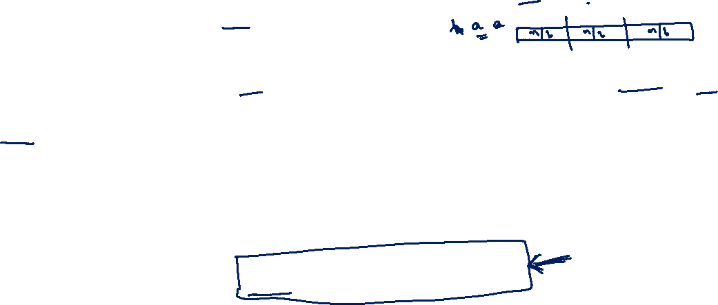
Divide-and-Conquer Recurrence Relations
Suppose that a recursive algorithm divides a problem of size n into a subproblems, where each subproblem is of size $n/b.$
Also, suppose that a total of $g(n)$ extra operations are required in the conquer step of the algorithm to combine the solutions of the subproblems into a solution of the original problem.
Then, if $f (n)$ represents the number of operations required to solve the problem of size $n$, it follows that $f$ satisfies the recurrence relation
$$f (n) = af (n∕b) + g(n).$$

Slide 26
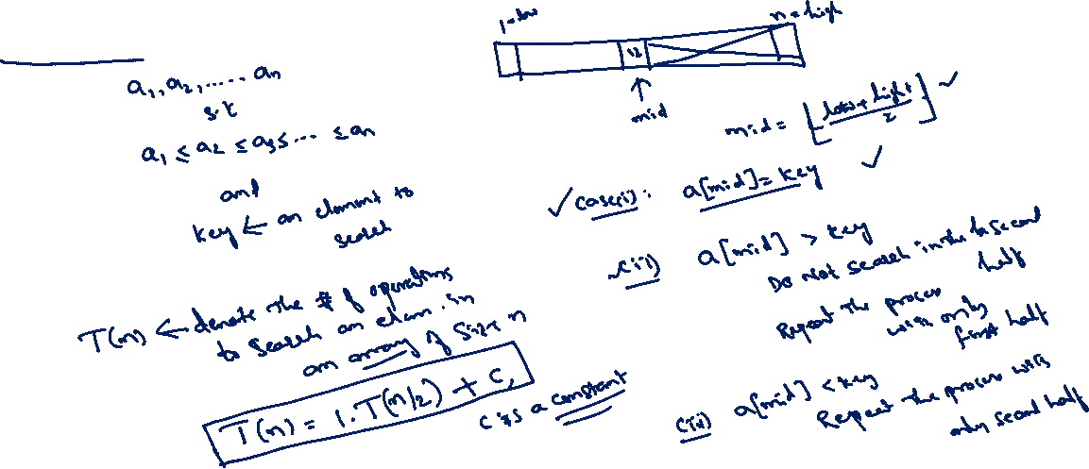
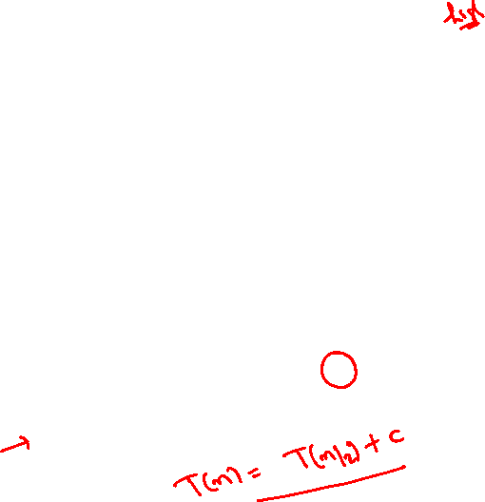
Divide-and-Conquer Recurrence Relations
Binary Search

Slide 27

Divide-and-Conquer Recurrence Relations
Finding the maximum of a sequence

Slide 28



Divide-and-Conquer Recurrence Relations
Merge Sort

Slide 29


Divide-and-Conquer Recurrence Relations
Let $n = b^{k}$, where $k$ is a positive integer. Then
$$f (n) = af (n∕b) + g(n)$$
$$= a^{2}f (n∕b^{2}) + ag(n∕b) + g(n)$$

Slide 30


Asymptotic Complexity and Notations
Running time of an algorithm as a function of input size n for large n.
Expressed using only the highest-order term in the expression for the exact running time.
Instead of exact running time, say $O(n2)$.
Describes behavior of function in the limit.
Asymptotic Notation: $O, θ, Ω$

Slide 31



Big-O Notation
For function $g(n)$, we define $O(g(n))$, as the set:
$$O(g(n)) = \{f(n) :  positive constants c and n0 such that n  n0,$$
$$we have 0  f(n)  cg(n) \}$$
Intuitively: Set of all functions whose rate of growth is the same as or lower than that of $g(n)$.
Examples:
$5n+100∈O\left(n^{2}\right)$
$10n^{2}+15∈O\left(n^{2}\right)$
$10n^{2}+15∈O\left(n^{3}\right)$

Slide 32


$Ω−$ Notation
For function $g(n)$, we define $Ω(g(n))$, as the set:
$$Ω(g(n)) = \{f(n) : there eists positive constants c and n0 such that n  n0,$$
$$we have 0 ≤ cg\left(n\right)≤f(n) \}$$
Intuitively: Set of all functions whose rate of growth is the same as or higher than that of $g(n)$.
Examples:
$5n+100∈Ω\left(n\right)$
$10n^{2}+15∈Ω\left(n^{2}\right)$
$10n^{2}+15∈Ω\left(n\right)$

Slide 33


$Θ−$ Notation
For function $g(n)$, we define $Θ(g(n))$, as the set:
$$Θ(g(n)) = \{f(n) : there eists positive constants c_{1}, c_{2}, and n0 such that n≥ n0,$$
$$we have 0≤c_{1}g\left(n\right)≤f\left(n\right)≤c_{2}g(n)\}$$
Examples:
$5n+100∈Θ\left(n\right)$
$10n^{2}+15∈Θ\left(n^{2}\right)$
$10n^{2}+15∉Ω\left(n^{3}\right)$

Slide 34
Divide-and-Conquer Recurrence Relations

Slide 36

MASTER THEOREM
Complexity of Merge Sort:
Other example:
$f\left(n\right)=3f\left(\frac{n}{2}\right)+cn$where $c$is a constant

Slide 37


MASTER THEOREM (Examples)
$f\left(n\right)=f\left(\frac{n}{3}\right)+1$
$f\left(n\right)=f\left(\frac{n}{5}\right)+3n^{2}$
$T\left(n\right)=2T\left(\frac{n}{2}\right)+n^{4}$
$T\left(n\right)=16T\left(\frac{n}{4}\right)+n^{2}$

Slide 38

MASTER THEOREM (Examples)
$T\left(n\right)=7T\left(\frac{n}{2}\right)+n^{2}$
$T\left(n\right)=2T\left(\frac{n}{4}\right)+√n$
$T\left(n\right)=T\left(\frac{7n}{10}\right)+n$

Slide 39
Thank You!!

